Slide 1
REVIEW 3 · PROPOSED SYSTEM DESIGN
RAILWAY
RESERVATION
SYSTEM
A guided journey from trip search to confirmed booking
Notes:
Introduce this as a Review 3 proposal. The focus is the design of a clear railway reservation journey, not a claim about a deployed or already tested system.

Slide 2
PROJECT AIM
ONE CLEAR JOURNEY FROM TRIP SEARCH TO CONFIRMED BOOKING
ONE CLEAR
JOURNEY
Make train discovery, availability checks, passenger entry, and ticket access feel like one understandable journey.
PROPOSAL FRAME
DESIRED EXPERIENCE
Design choices to review, not claims about current service failures.
Fewer handoffs, clearer decisions, easier ticket access.
SEARCH · CHECK · ENTER · CONFIRM
Notes:
State the project aim in one sentence. Emphasize that this is a design proposal and keep the discussion anchored on the experience the system should create.

Slide 3


PROPOSED METHOD · BOOKING JOURNEY
THE PROPOSED METHOD CONNECTS EACH BOOKING STEP
Official IRCTC e-ticket guidance describes route and train search, class and fare checks, availability checks, passenger details, and payment.
Search
Compare
Reserve
Present
Choose origin, destination, date, and class.
Review train options, fares, and availability.
Enter passenger details and complete payment.
Retrieve and present the e-ticket.
Notes:
Walk left to right. Search begins the journey, comparison supports the decision, reservation completes the transaction, and presentation closes the loop with the e-ticket.

Slide 4



PROPOSED CONTRIBUTION
THE PROPOSED CONTRIBUTION IS A SIMPLER, MORE TRANSPARENT BOOKING FLOW
Design contribution · proposed for review, not presented as proven global novelty
One guided journey
Earlier visibility
Honest scope
Bring search, availability, booking, and ticket access into a single guided flow.
Make fare and availability visible before passenger details are entered.
Describe these as proposed design contributions, not completed features or proven novelty.
Notes:
Frame the contribution carefully. The value proposed here is a simpler and more transparent flow. Avoid claiming that the system is globally novel or already complete.

Slide 5
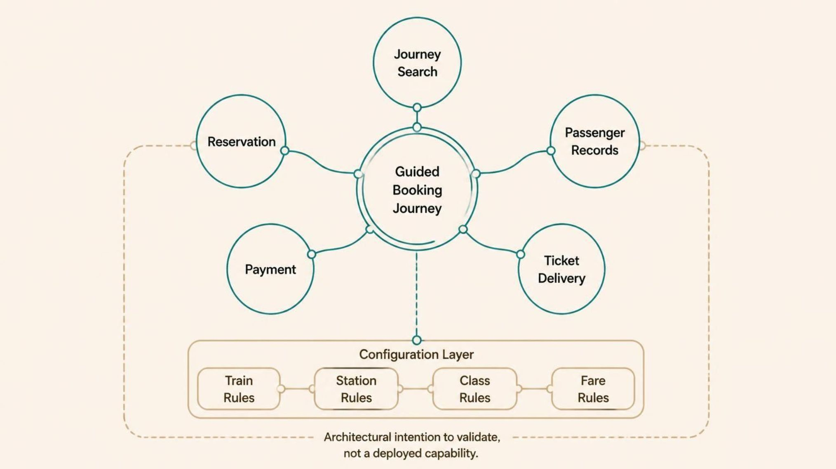
ARCHITECTURAL INTENTION
MODULAR COMPONENTS MAKE THE APPROACH ADAPTABLE
ADAPTABLE
BY DESIGN
Separate the journey into components that can be configured and validated independently.
CONFIGURE RULES · VALIDATE BOUNDARIES
PROPOSED BOUNDARY · TRAIN, STATION, CLASS, AND FARE RULES REMAIN CONFIGURABLE
Notes:
Use the hub to explain the intended boundaries. The components are separated so the approach can adapt, while rules such as train, station, class, and fare remain configurable rather than hard-coded.

Slide 6
EVALUATION PLAN
EVALUATE THE METHOD WITH TASKS, NOT INVENTED RESULTS
Results remain placeholders until a real evaluation is conducted.
REPRESENTATIVE TASKS
MEASURES TO REPORT
01
Find a train
Completion
Search by route, date, and class.
Whether participants finish each task.
02
Compare availability
Errors
Review options and fare information.
Where confusion or recovery occurs.
Time
03
Reserve a seat
How long each task takes.
Enter details and complete payment.
Reported ease
04
Retrieve a ticket
What users say about the experience.
Locate the e-ticket after booking.
REPORT SAMPLE, METHOD, TASK SCRIPT, AND RESULTS TOGETHER
Notes:
Make the evaluation plan concrete without fabricating findings. Name the four tasks, then the four measures. When results exist, report the sample and method alongside them.

Slide 7
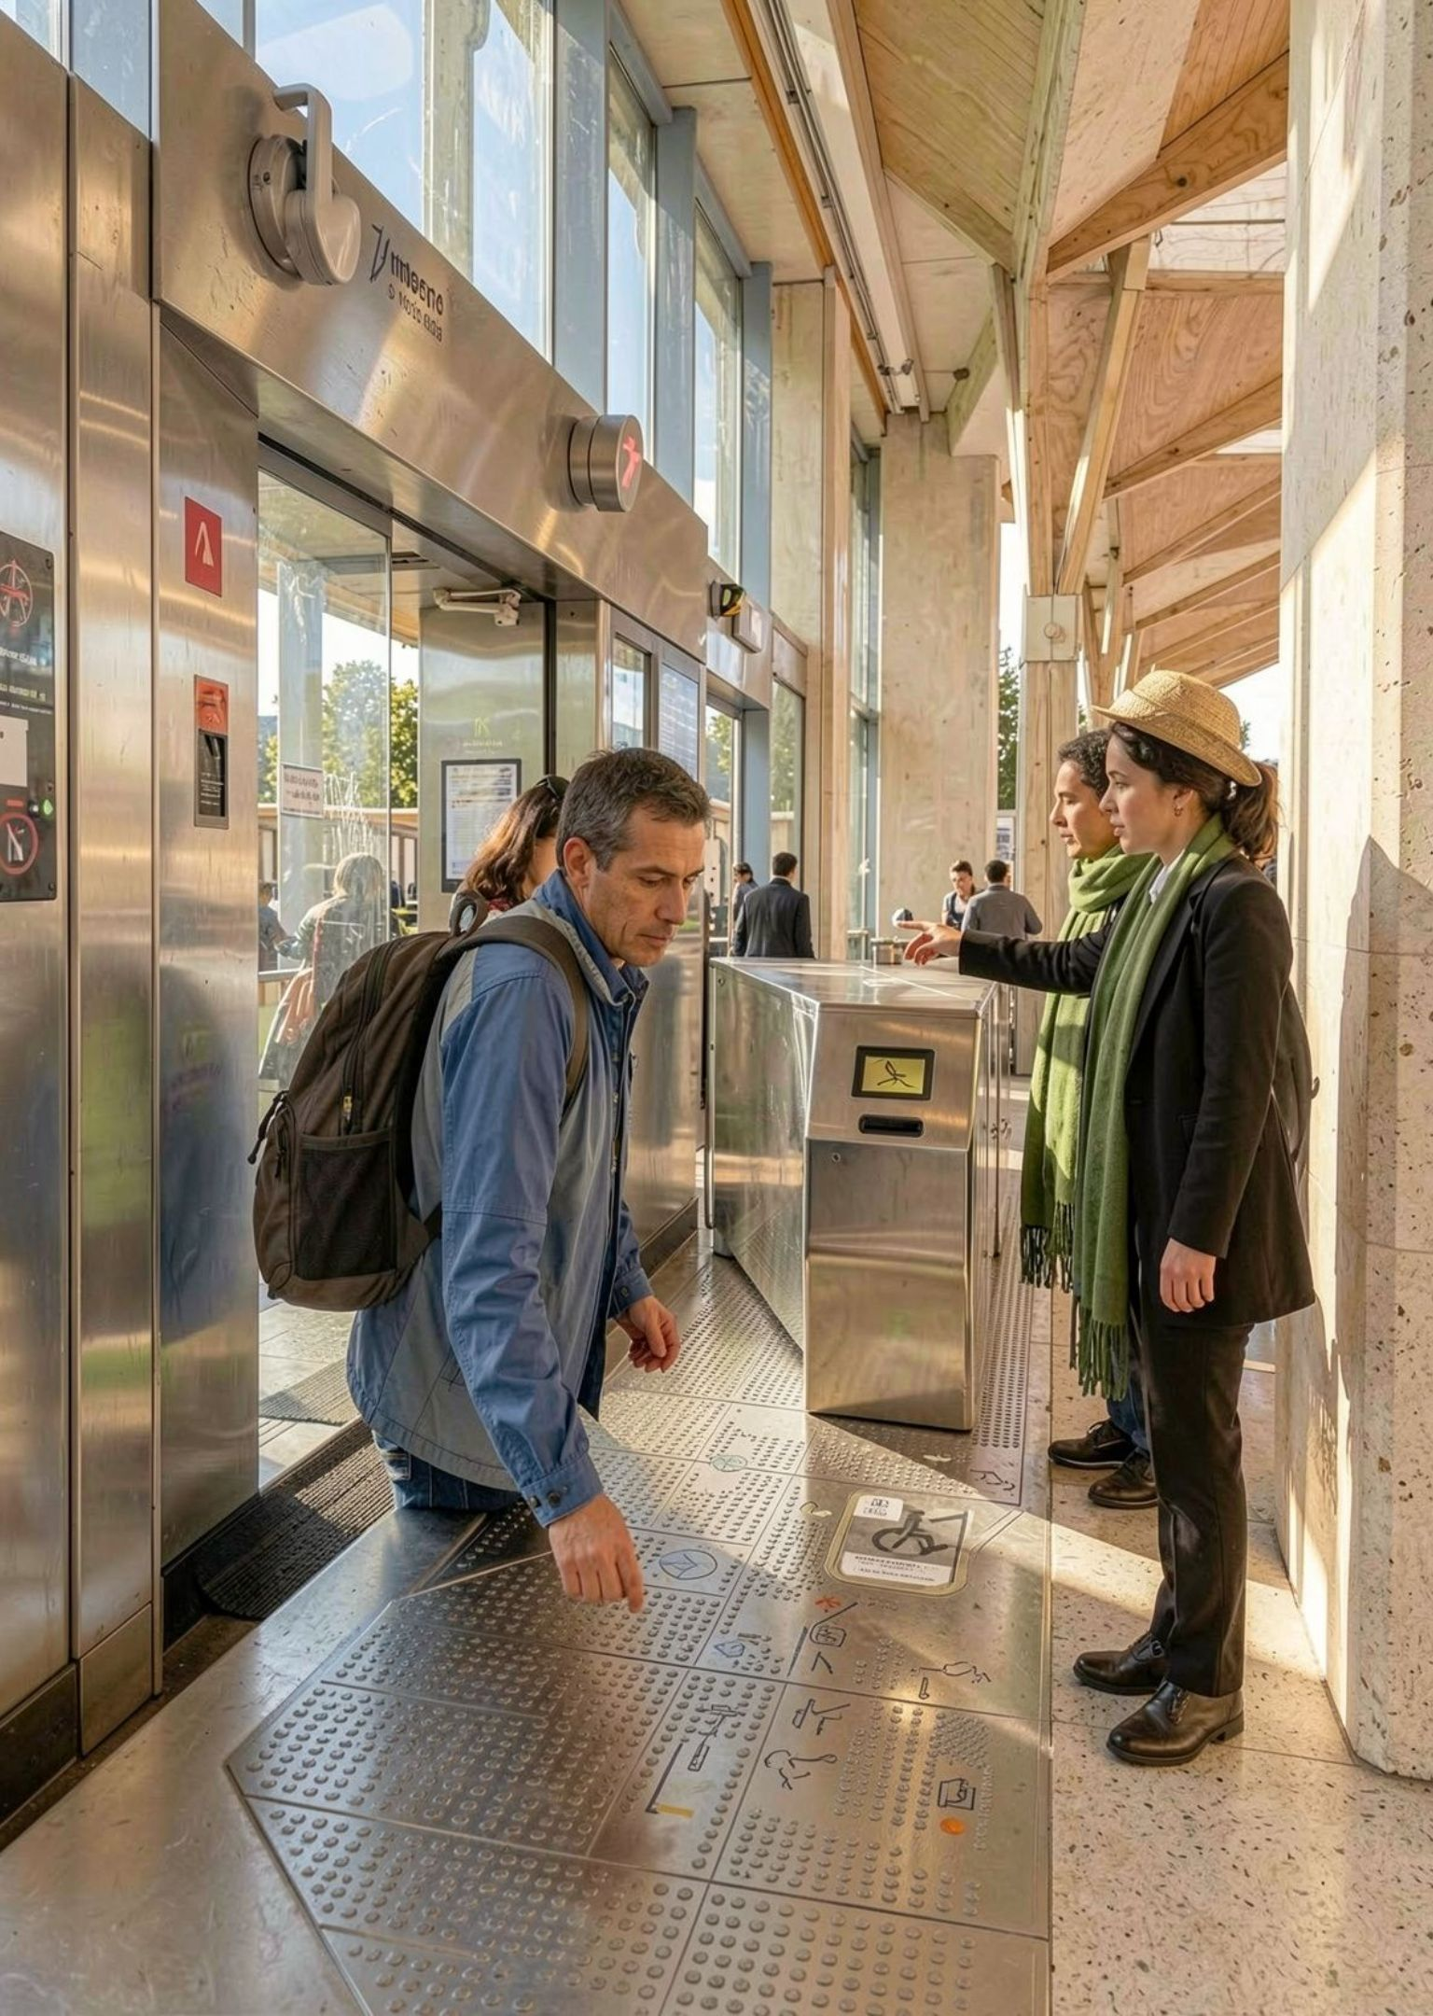
RECOMMENDATIONS
ACCESSIBILITY AND DISSEMINATION BELONG IN THE DESIGN
Design for readable interaction, then make the proposal easy to inspect and share.
Accessible interaction
Readable layouts, keyboard-friendly navigation, clear status messages, and plain-language error recovery.
Accessible dissemination
Share a short demo, architecture summary, and accessible project report.
STATUS
Recommendations unless implemented and tested.
Notes:
Accessibility is part of the proposed design, not a compliance claim. Explain both the interaction recommendations and the dissemination plan, then label their status honestly.

